Slide 1


Traditional Programming
Data Program
Output
Machine Learning
Data
Output
Program

Slide 2
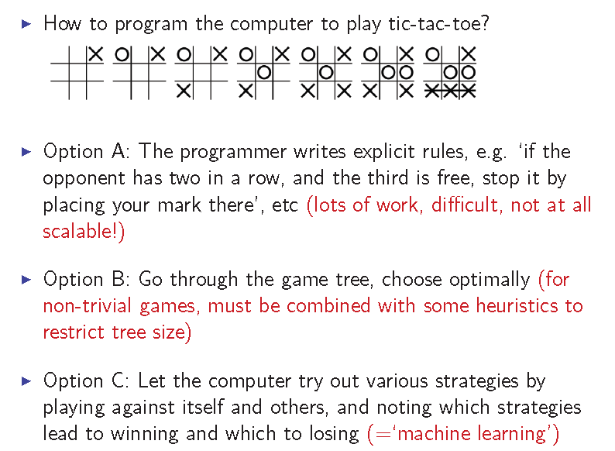
Examples
Example 1 : Tic-Tac-Toe

Slide 3
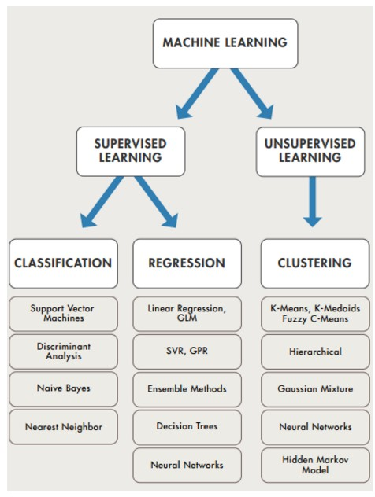

Slide 4
Supervised Learning
In supervised learning, we are given a data set and already know what our correct output should look like, having the idea that there is a relationship between the input and the output.
Supervised learning problems are categorized into "regression" and "classification" problems.
In a regression problem, we are trying to predict results within a continuous output, meaning that we are trying to map input variables to some continuous function.
In a classification problem, we are instead trying to predict results in a discrete output. In other words, we are trying to map input variables into discrete categories.

Slide 5
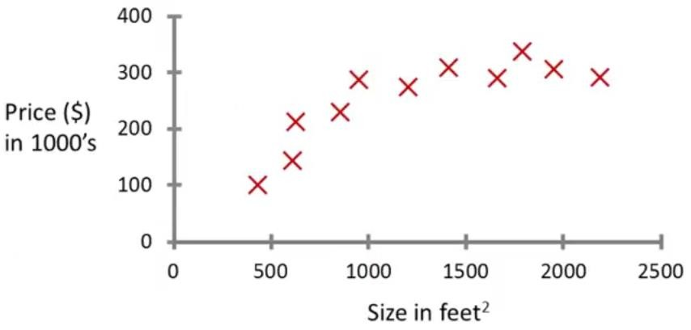
250
175
750
Supervised Learning
Regression:
“right answers” or “Labeled data” given
Predict continuous valued output (price)

Slide 6
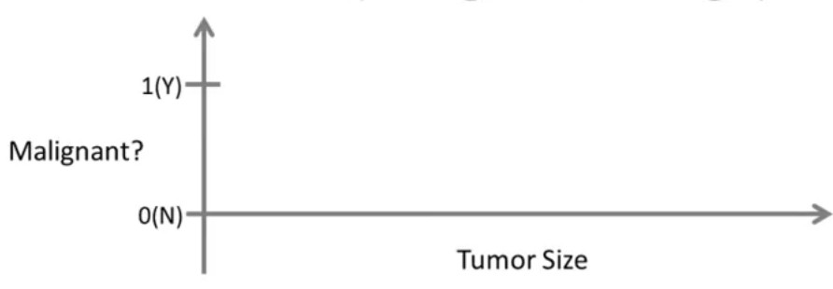













Lung Cancer
(Malignant or benging)
Classification
Discrete valued output (0 or 1)

Slide 7
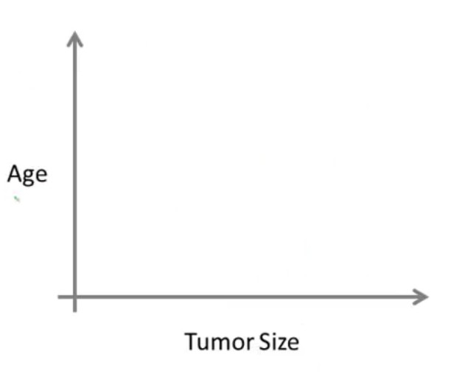







































Slide 8
Unsupervised Learning
Unsupervised learning, on the other hand, allows us to
approach problems with little or no idea what our results
should look like.
We can derive structure from data where we don't necessarily know the effect of the variables.
We can derive this structure by clustering the data based on
relationships among the variables in the data.
With unsupervised learning there is no feedback based on the prediction results, i.e., there is no teacher to correct you.

Slide 9

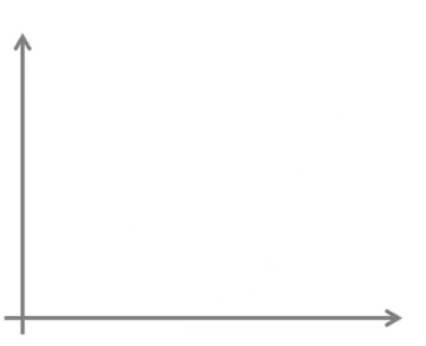











Y
X

Slide 10
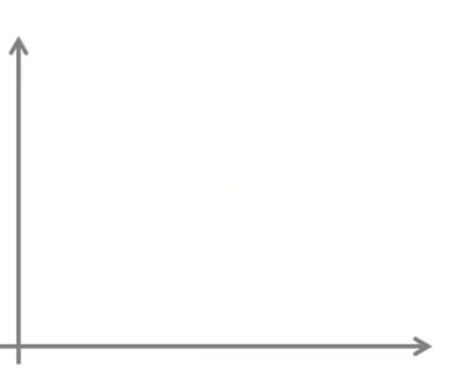


















Unsupervised
Y
X
Unsupervised learning is where you only have input data and no corresponding output variables.

Slide 11



